Slide 1

Nashville Cemetery
Zach Cate

Slide 2

Cemetery Origin
Established in 1822
Originated as a burial ground for the early settlers and pioneers of Nashville
Cemetery records showcase the city’s growth and population shifts throughout the years

Slide 3
Notable Occupants
Charles Dickinson – Killed by Andrew Jackson in a duel in 1806
James Robertson – Founder of Nashville
Ella Sheppard – Leader of the original Fisk Jubilee Singers
Various former mayors and city officials

Slide 4
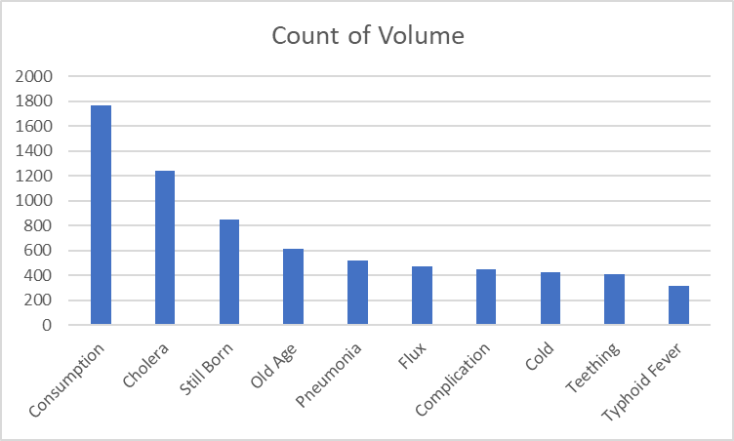
Causes of Death
Deaths
Consumption is a term used to cover deaths related to tuberculosis
Limited medical understanding caused confusion
Large number of deaths recorded with cause unknown

Slide 5
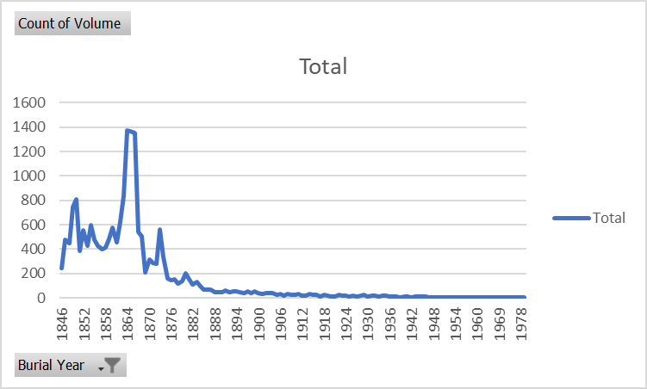
Burials Over Time
Burials
Huge spike during the Civil War
Other spikes might be disease-related
Didn’t see much use after late 1800s

Slide 6

Questions?

